Slide 1
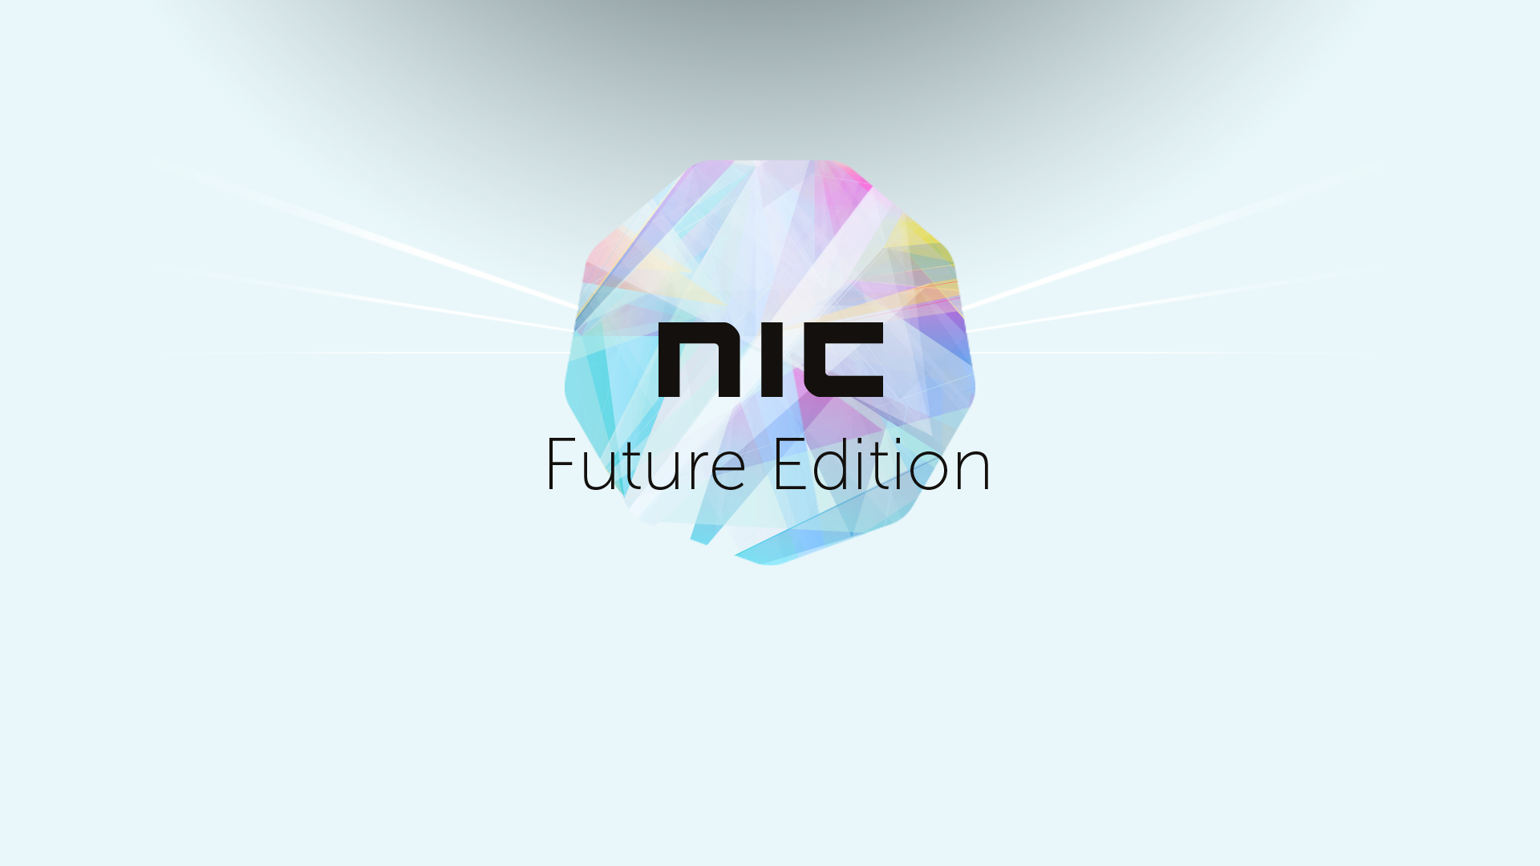

Slide 2




Automation on AWS for Microsoft Workloads
Danilo Poccia
Technical Evangelist
danilop@amazon.com
@danilop
danilop

Slide 3
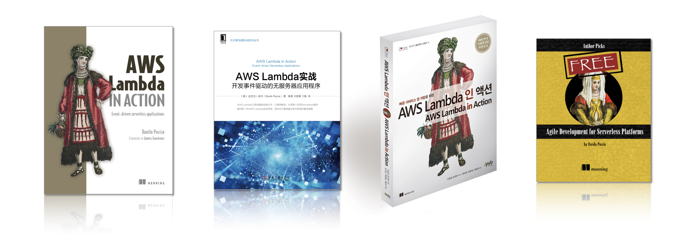

Slide 4
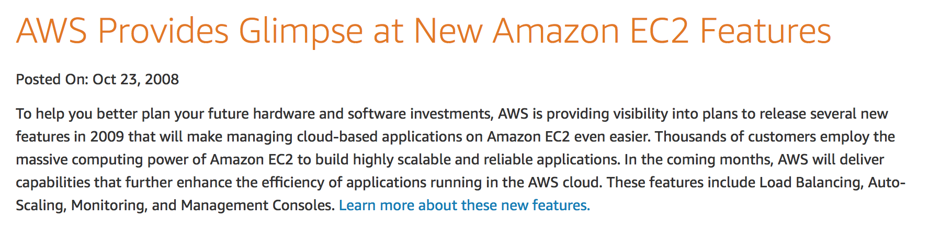
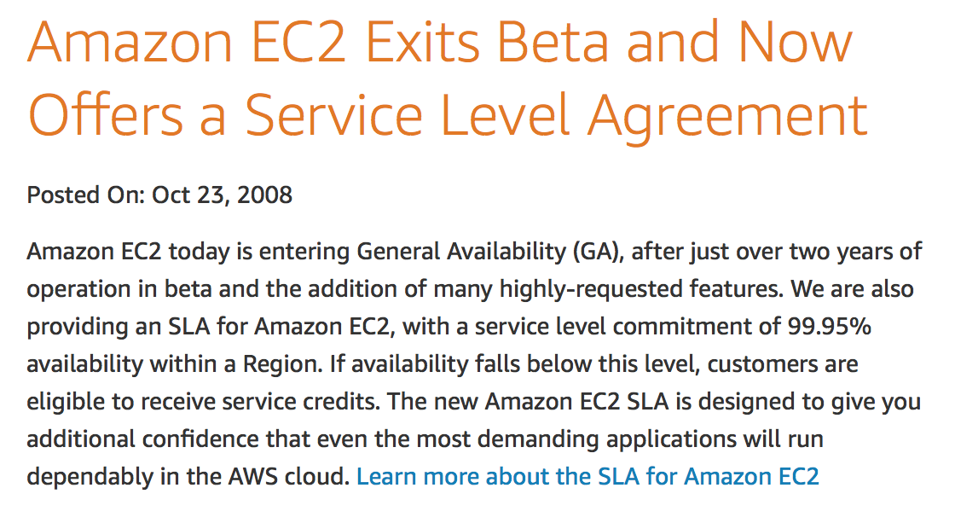
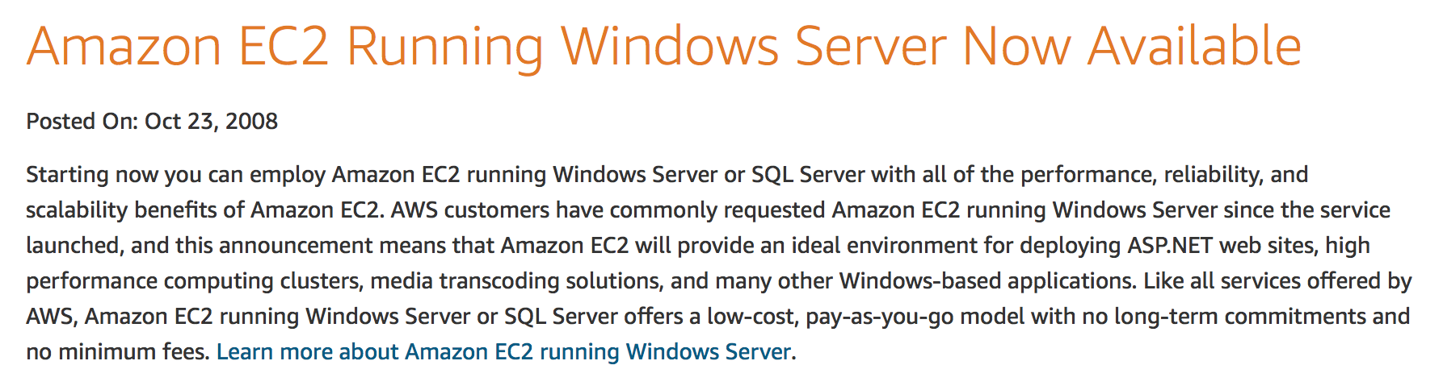
Oct 23, 2008

Slide 5




Amazon Machine Image (AMI)
EC2 instance
create image
EC2 instance(s)
AMI
VM import/export
On-premises server

Slide 6
User Data and Scripts
EC2 instance
create image
EC2 instance(s)
AMI
VM import/export
On-premises server
User Data and Scripts
<script> dir > c:\test.log </script>
<powershell>
Rename-Computer -NewName user-data-test Read-S3Object -BucketName myS3Bucket -Key myFolder/myFile.zip -File c:\destinationFile.zip </powershell>

Slide 7
Static Vs Dynamic AMIs
EC2 instance(s)
AMI
Always the same
Static
Images
Dynamic Images
Reconfigure instance at first boot
Patching Final Configurations Software Upgrades

Slide 8
AMI Windows Tools
EC2 instance(s)
AMI
Initial Instance Boot Tasks
EC2Launch EC2Config
EC2Rescue
Troubleshoot OS-level Issues Collect Logs and Config Files

Slide 9
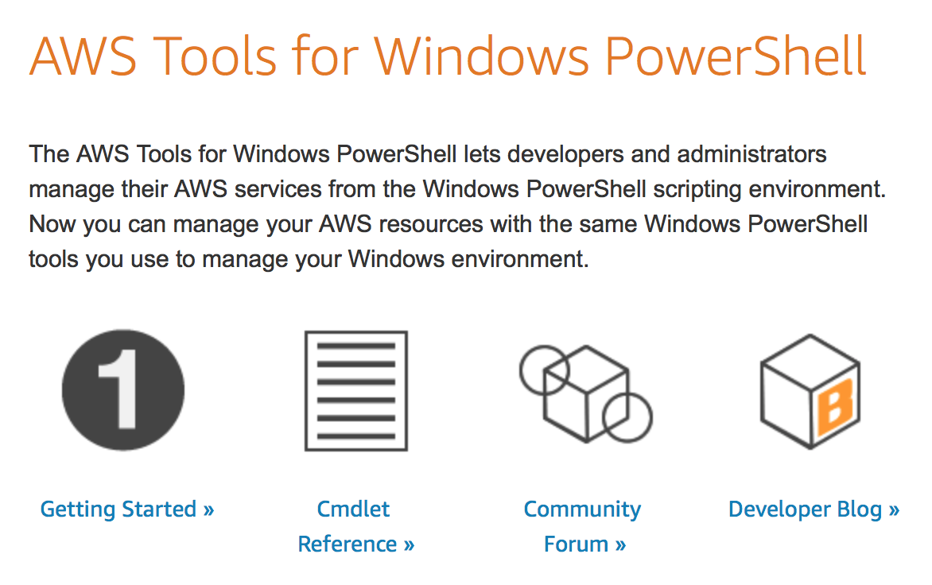
AWS Tools for Windows PowerShell

Slide 10
AWS Tools for Windows PowerShell
PS C:\> Start-EC2Instance -InstanceIds i-10a64379
foreach ($i in Get-ChildItem C:\Logs) { if ($i.CreationTime -lt ($(Get-Date).AddDays(-7))) { if ($i.Length -gt 0) { Write-S3Object -BucketName mylogbucket -Key Logs/$i -File $i.FullName } Remove-Item $i.FullName } }
# Publish a custom metric to your Amazon CloudWatch dashboard $dat = New-Object Amazon.CloudWatch.Model.MetricDatum $dat.Timestamp = (Get-Date).ToUniversalTime() $dat.MetricName = "New Posts” $dat.Unit = "Count” $dat.Value = $newPostCount Write-CWMetricData -Namespace "Usage Metrics" -MetricData $dat

Slide 11
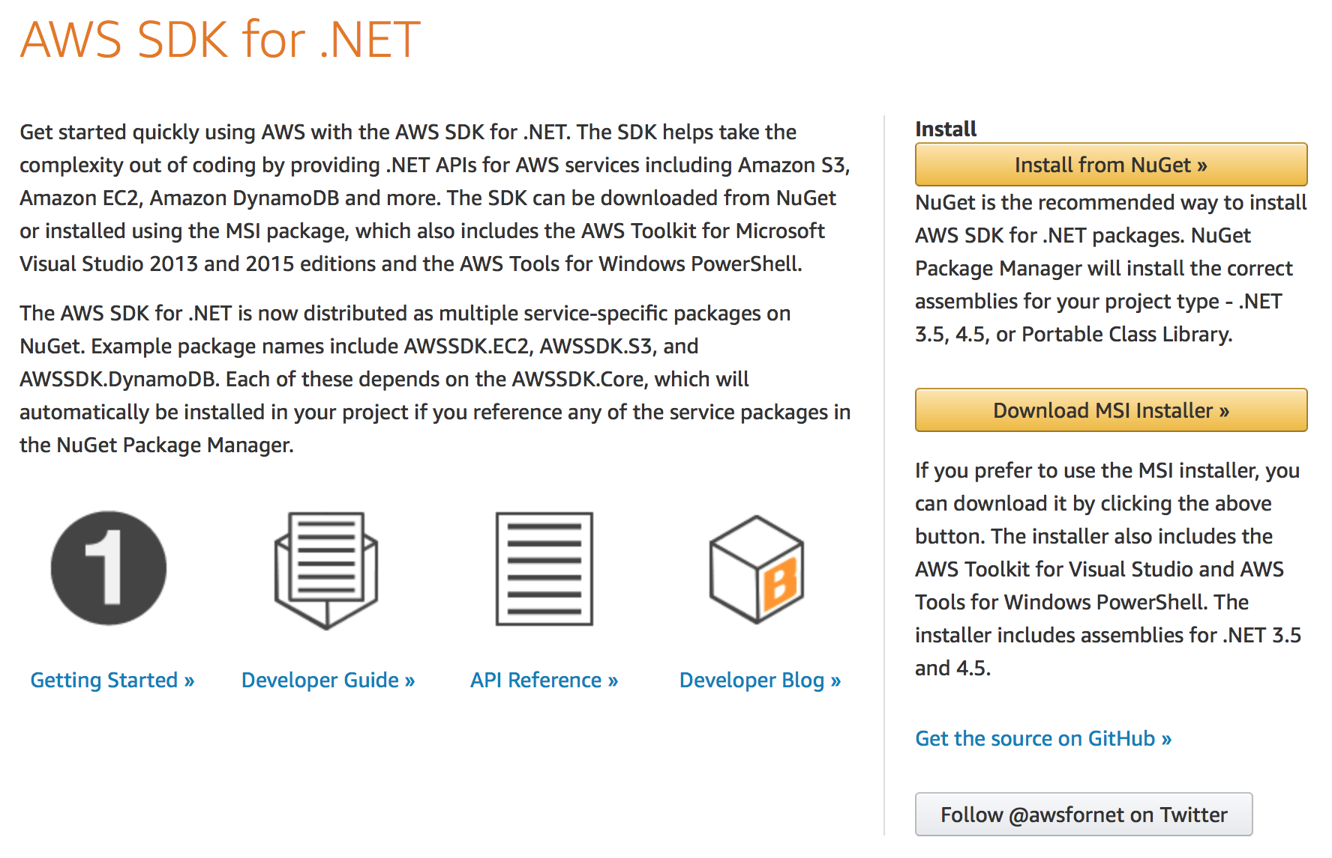
AWS SDK for .NET
.NET Core Support
Amazon S3 TransferUtility
Amazon S3 Client-side Encryption
Amazon DynamoDB Object Persistence Framework
Amazon Glacier ArchiveTransferManager
Support for Portable Class Library and Xamarin Projects
Amazon DynamoDB Session State Provider
https://github.com/aws/aws-sdk-net
https://github.com/aws/aws-logging-dotnet

Slide 12
AWS Global Infrastructure

Slide 13
Regions and Availability Zones
Each region is completely independent.
Each Availability Zone is isolated, but the Availability Zones in a region are connected through low-latency links.

Slide 14
AWS Global Infrastructure
52 Availability Zones (AZs) within 18 geographic Regions, with announced plans
for 12 more AZs and 4 more Regions

Slide 15
AWS Edge Network
113 Points of Presence (102 Edge Locations and 11 Regional Edge Caches) in 56 cities across 24 countries

Slide 16
Infrastructure Automation

Slide 17



Infrastructure as Code
Templates
create
Stacks
update
Change Sets

Slide 18
Auto Scaling
AWS Auto Scaling
Amazon EC2
Amazon EC2 Spot Fleets
Amazon ECS
Amazon DynamoDB
Amazon Aurora

Slide 19
Managed Directories
AD Connector
Simple AD
Microsoft AD
Simple
Powerful
AD Connector uses your existing on-premises Microsoft Active Directory to access AWS applications and services.
Simple AD is a Microsoft Active Directory–compatible directory that is powered by Samba 4 and hosted on the AWS cloud.
Microsoft AD is a Microsoft Active Directory hosted on the AWS Cloud. It integrates most Active Directory features with AWS applications.

Slide 20
Managed Databases
Amazon RDS for SQL Server
SQL Server on Amazon EC2
Versions supported:
2008 R2, 2012, 2014, 2016
2005, 2008, 2008 R2, 2012, 2014, 2016, 2017
Editions supported:
Express, Web, Standard, Enterprise
HA and scaling:
Multi-AZ deployment, instance scaling
Self-managed; AlwaysOn, mirror, log ship
Encryption:
Encrypted storage using AWS KMS (all editions); TDE support
Authentication:
Windows and SQL Server authentication
Backups:
Managed automated backups
Maintenance plans and third-party tools
Maintenance:
Automatic software patching, instance replacement
Self-managed
Read replicas:
AWS DMS, third-party
Self-managed, AWS DMS, third-party
Licensing:
BYOL, license included
BYOL, license included AMI

Slide 21
AWS Systems Manager
Resource Groups
Insights Dashboard
Inventory
Automation
Run Command
Patch Manager
Maintenance Window
State Manager
Parameter Store

Slide 22
AWS Systems Manager

Slide 23
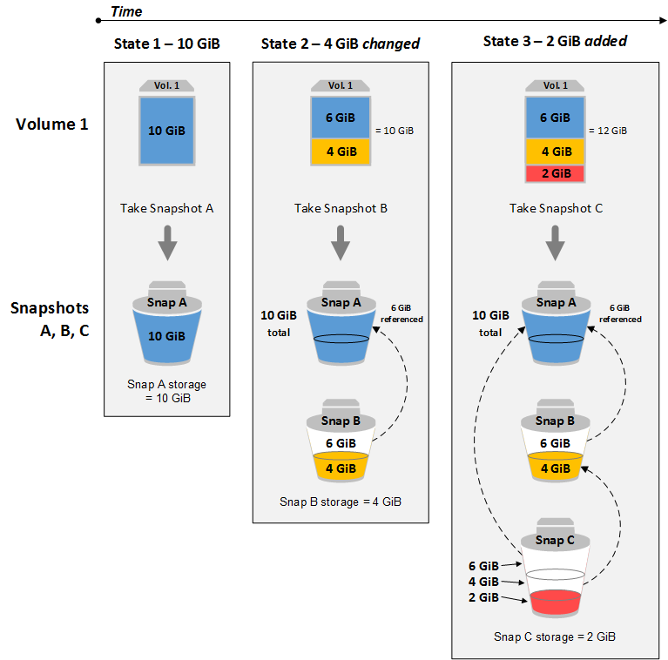
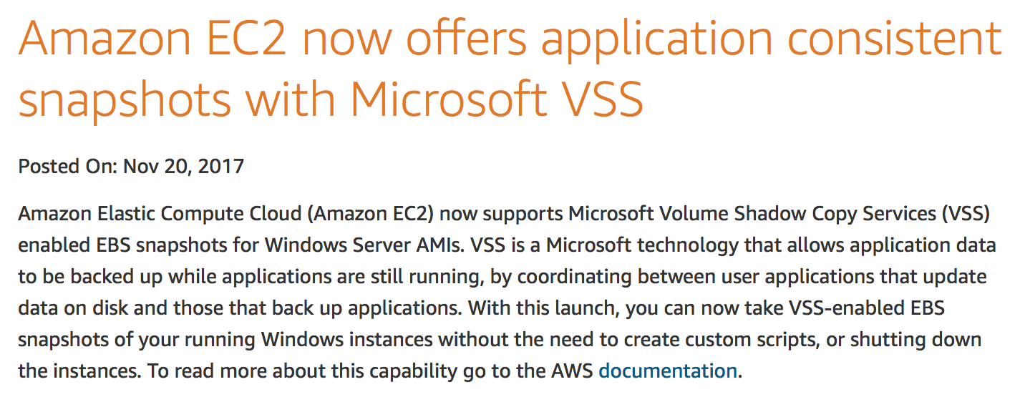
Consistent Snapshots with Microsoft VSS

Slide 24
More Automation

Slide 25
Container Management
Amazon ECS (Elastic Container Service)
Amazon EKS
(Amazon Elastic Container Service
for Kubernetes)
Amazon ECR (Elastic Container Registry)

Slide 26
Run containers without managing servers or clusters
AWS Fargate

Slide 27
Managed Applications
AWS Elastic Beanstalk
Application
Version
Environment
Version 1
Production
Version 2
My Web App
User Acceptance
Version 3
Test
Version 4

Slide 28
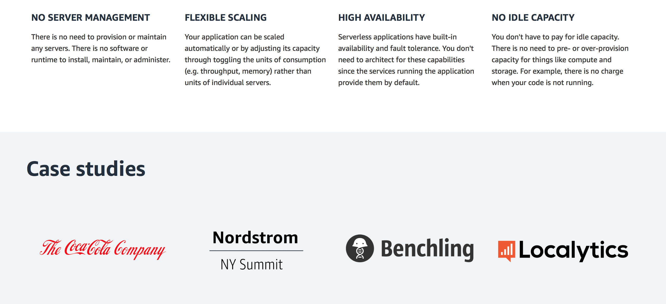
Serverless Computing
https://aws.amazon.com/serverless/

Slide 29
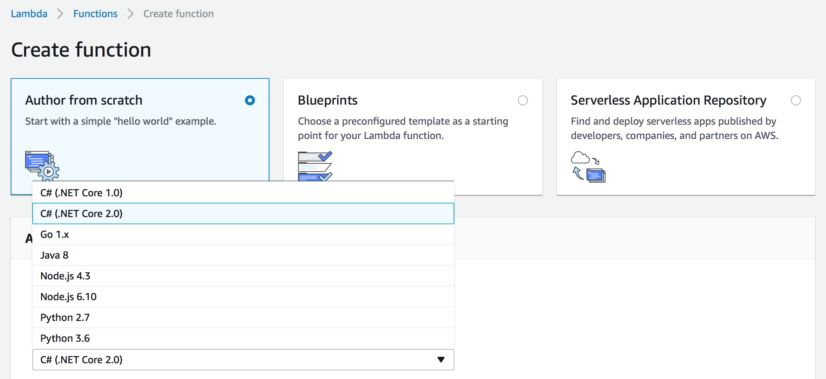
Serverless Computing
https://github.com/aws/aws-lambda-dotnet

Slide 30
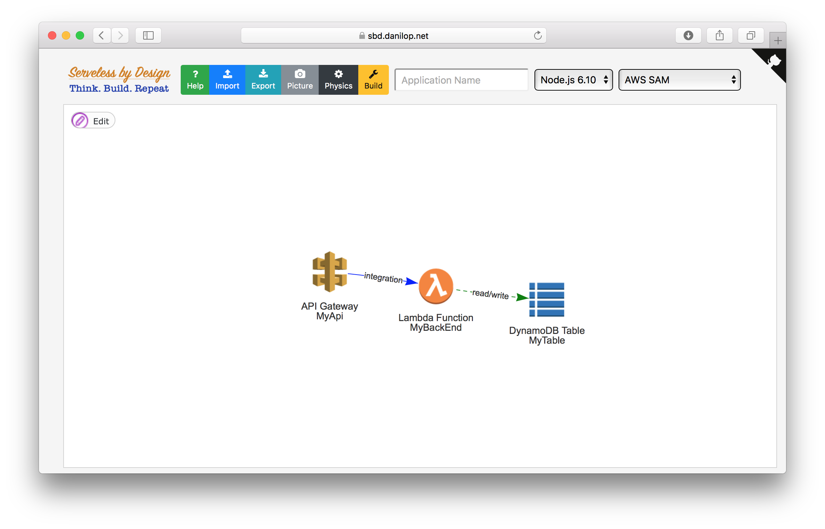

Serverless by Design
https://sbd.danilop.net
https://github.com/danilop/ServerlessByDesign

Slide 31
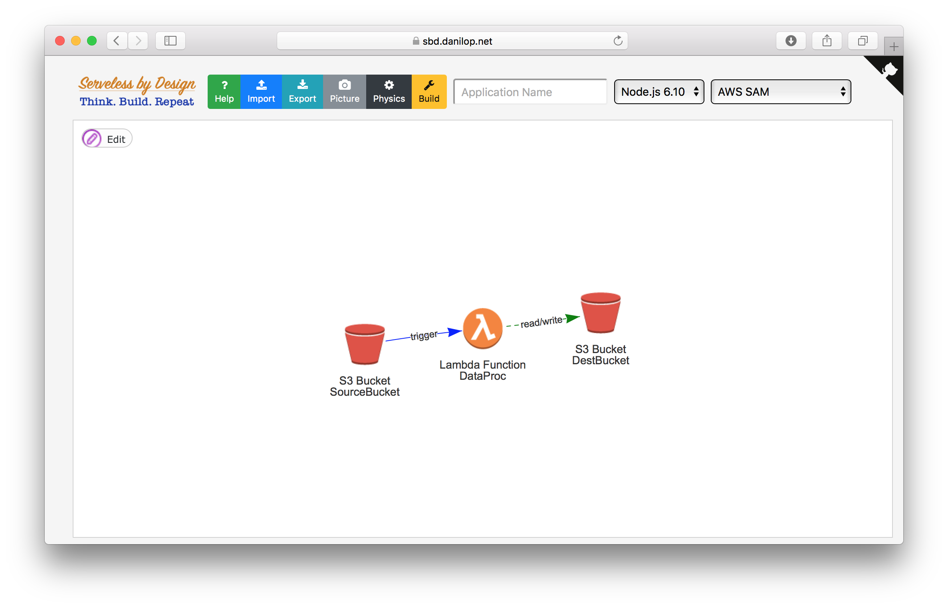
Serverless by Design
https://sbd.danilop.net
https://github.com/danilop/ServerlessByDesign

Slide 32
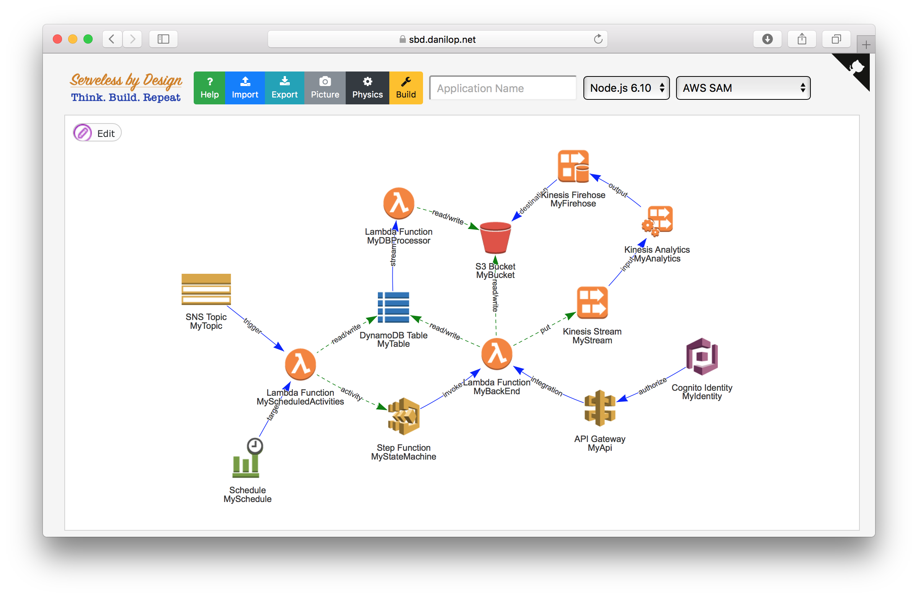
Serverless by Design
https://sbd.danilop.net
https://github.com/danilop/ServerlessByDesign

Slide 33
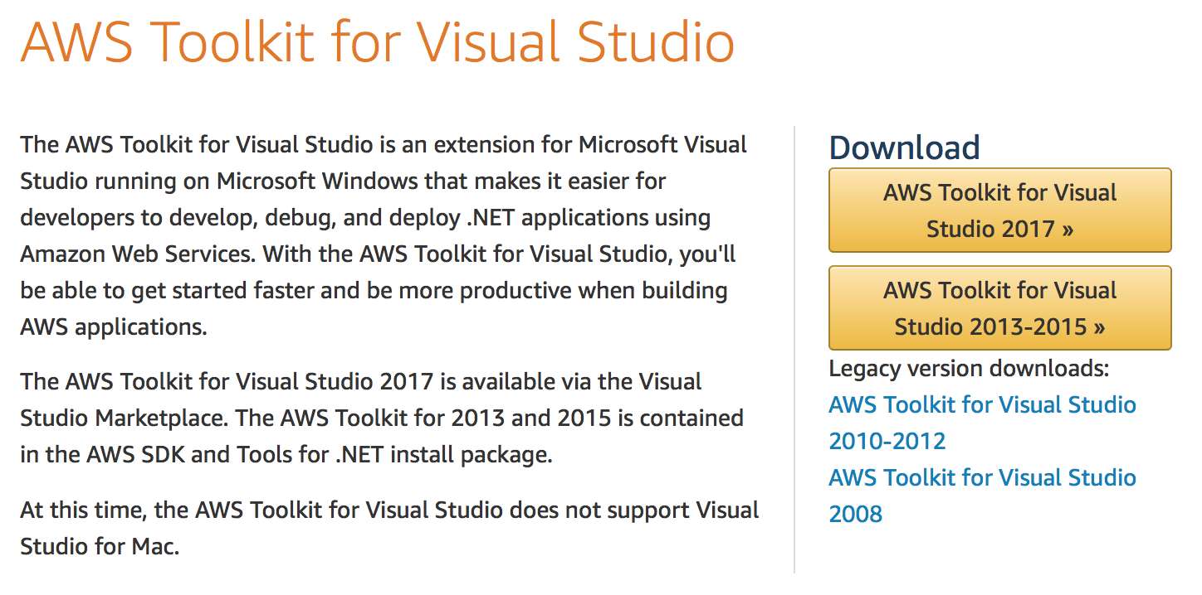
AWS Toolkit for Visual Studio

Slide 34
AWS Toolkit for Visual Studio
AWS Elastic Beanstalk
Use the AWS Toolkit for Visual Studio to develop, debug, then deploy your .NET web applications using a web application template. Use Visual Studio to build and run your application locally before deploying to AWS Elastic Beanstalk.
AWS Lambda and Amazon API Gateway
Create serverless applications with minimal administration and event-driven scaling with C# and Node.js using AWS Lambda and Amazon API Gateway.
Amazon Elastic Container Service
Easily build, register and deploy .NET Core Docker applications to the Amazon Elastic Container Service without ever leaving Visual Studio.
AWS Explorer
The AWS Explorer lets you manage your AWS resources. Including your Amazon S3 Objects, Amazon DynamoDB Tables and EC2 instances.
CloudFormation Editor
Create new .NET web applications using an application template. Use Visual Studio to build with the convenience of IntelliSense and deploy to AWS with AWS CloudFormation.
Project Templates
The AWS Toolkit for Visual Studio includes project templates for AWS Lambda functions, AWS CloudFormation templates and sample projects showing how to use various AWS services.
Notes:
AWS Elastic Beanstalk Use the AWS Toolkit for Visual Studio to develop, debug, then deploy your .NET web applications using a web application template. Use Visual Studio to build and run your application locally before deploying to AWS Elastic Beanstalk. Learn more »
AWS Lambda and Amazon API Gateway Create serverless applications with minimal administration and event-driven scaling with C# and Node.js using AWS Lambda and Amazon API Gateway.
Amazon Elastic Container Service Easily build, register and deploy .NET Core Docker applications to the Amazon Elastic Container Service without ever leaving Visual Studio. Learn More »
AWS Explorer The AWS Explorer lets you manage your AWS resources. Including your Amazon S3 Objects, Amazon DynamoDB Tables and EC2 instances.
CloudFormation Editor Create new .NET web applications using an application template. Use Visual Studio to build with the convenience of IntelliSense and deploy to AWS with AWS CloudFormation. Learn more »
Project Templates The AWS Toolkit for Visual Studio includes project templates for AWS Lambda functions, AWS CloudFormation templates and sample projects showing how to use various AWS services.

Slide 35
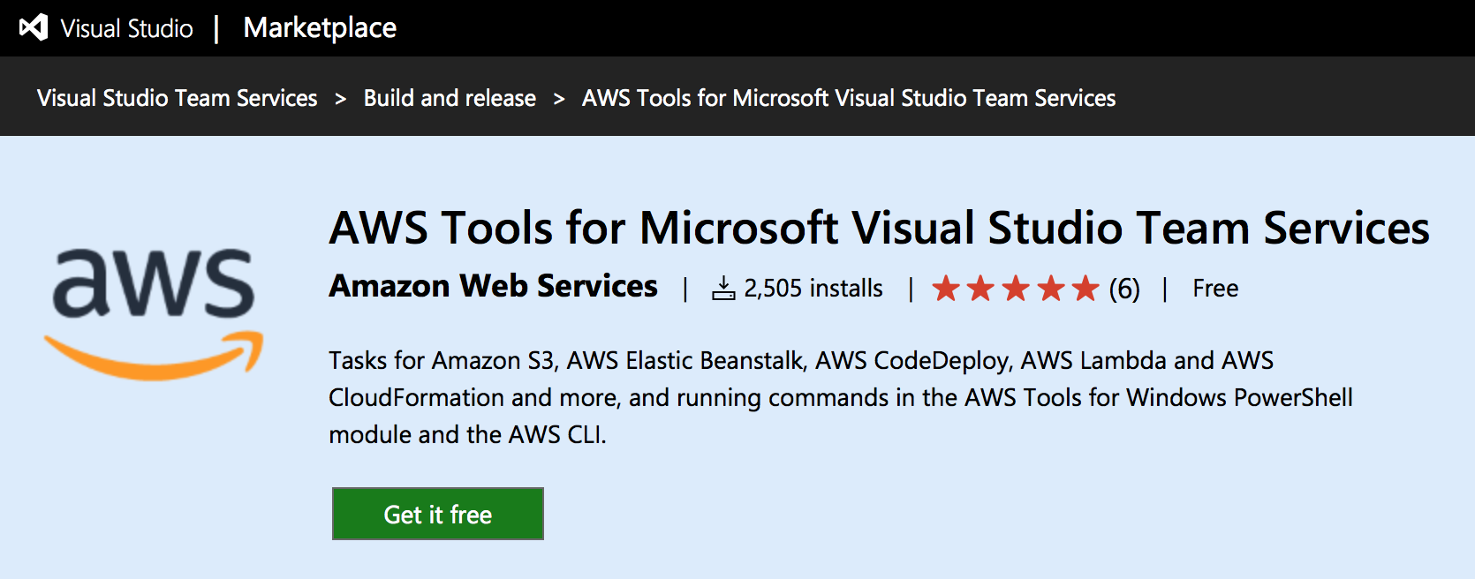
AWS Tools for Microsoft Visual Studio Team Services
https://github.com/aws/aws-vsts-tools

Slide 36
AWS Quick Starts

Slide 37
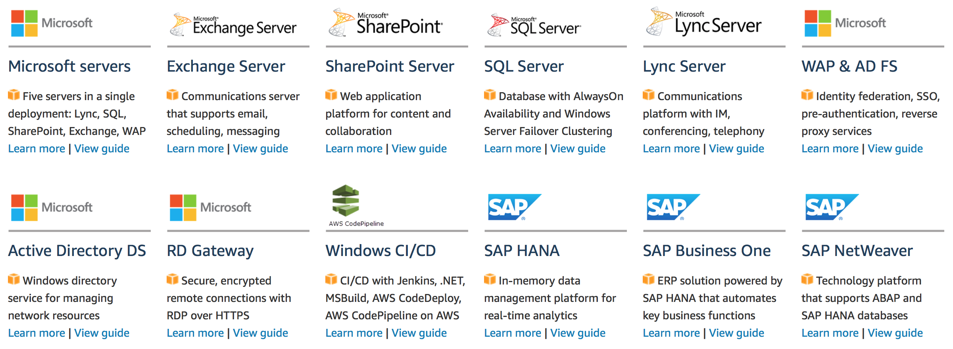
AWS Quick Starts
Automated gold-standard deployments on AWS
https://aws.amazon.com/quickstart/
https://github.com/aws-quickstart/

Slide 38
Active Directory DS on AWS
AWS Quick Starts
Create or extend your AD DS environment, or use with AWS Directory Service

Slide 39
SQL Server on AWS
AWS Quick Starts
Using Always On Availability Groups and Windows Server Failover Clustering

Slide 40
Microsoft Servers on AWS
AWS Quick Starts
Deploy Lync, Exchange, SharePoint, SQL Server, WAP & AD FS with one click

Slide 41
Windows CI/CD Pipeline on AWS
AWS Quick Starts
Using .NET, MSBuild, IIS, Jenkins, AWS CodePipeline, and AWS CodeDeploy

Slide 42
Windows Case Studies
https://aws.amazon.com/windows/case-studies/
Notes:
International Air Transport Association (IATA)

Slide 43
Takeaways
Cloud Computing provides an API to manage infrastructure and services.
Use Cloud Computing API via the CLI, SDKs or with management tools to automate your recurring tasks for availability, patching, scaling and monitoring.
Build elastic, self-healing infrastructures.
Manage your Infrastructure as Code, in template files, and apply software development best practices to infrastructure management.
Manage applications, non infrastructure components.
Business metrics can be more important than infrastructure metrics.
Speed up development with Continuous Integration and Continuous Deployment.
Containers simplify management of application components. Choose a container manager that allows you to automate the lifecycle of containers and applications.
Serverless architectures take care of availability, scalability, patching, and more, so that you can focus on your business logic. Event-driven architectures are easier to grow when adding new features.

Slide 44
Resources
Slides and demos from the conference will be available at github.com/nordicinfrastructureconference/2018 (bit.ly/2y7JhA3)

Slide 45
Automation on AWS for Microsoft Workloads
Danilo Poccia
Technical Evangelist
danilop@amazon.com
@danilop
danilop

